Slide 1

Chapter 13 (continued)
Advanced Implementation of Tables
© 2011 Pearson Addison-Wesley. All rights reserved
13 B-<number>

Slide 2
Red-Black Trees
A 2-3-4 tree
  Advantages
    It is balanced
    Its insertion and deletion operations use only one pass from root to leaf
  Disadvantage
    Requires more storage than a binary search tree
A red-black tree
  A special binary search tree
  Used to represent a 2-3-4 tree
  Has the advantages of a 2-3-4 tree, without the storage overhead
© 2011 Pearson Addison-Wesley. All rights reserved
13 B-<number>

Slide 3
Red-Black Trees
Basic idea
  Represent each 3-node and 4-node in a 2-3-4 tree as an equivalent binary tree
Red and black children references
  Used to distinguish between 2-nodes that appeared in the original 2-3-4 tree and 2-nodes that are generated from 3-nodes and 4-nodes
    Black references are used for child references in the original
    2-3-4 tree
    Red references are used to link the 2-nodes that result from the split 3-nodes and 4-nodes
© 2011 Pearson Addison-Wesley. All rights reserved
13 B-<number>

Slide 4
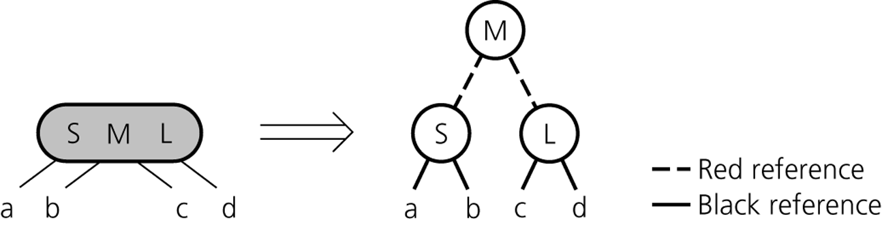
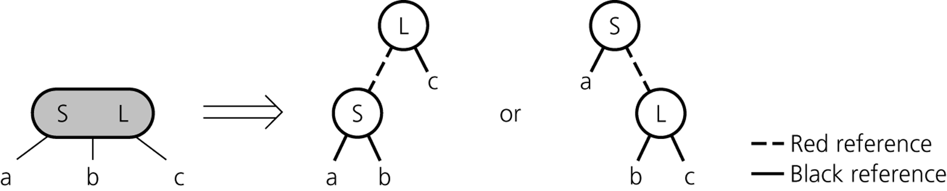
Red-Black Trees
Figure 13-31
Red-black representation of a 4-node
Figure 13-32
Red-black representation of a 3-node
© 2011 Pearson Addison-Wesley. All rights reserved
13 B-<number>

Slide 5
Red-Black Trees: Searching and Traversing a Red-Black Tree
A red-black tree is a binary search tree
The algorithms for a binary search tree can be used to search and traverse a red-black tree
© 2011 Pearson Addison-Wesley. All rights reserved
13 B-<number>

Slide 6
Red-Black Trees: Inserting and Deleting From a Red-Black Tree
Insertion algorithm
  The 2-3-4 insertion algorithm can be adjusted to accommodate the red-black representation
    The process of splitting 4-nodes that are encountered during a search must be reformulated in terms of the red-black representation
      In a red-black tree, splitting the equivalent of a 4-node requires only simple color changes
      Rotation: a reference change that results in a shorter tree
Deletion algorithm
  Derived from the 2-3-4 deletion algorithm
© 2011 Pearson Addison-Wesley. All rights reserved
13 B-<number>

Slide 7
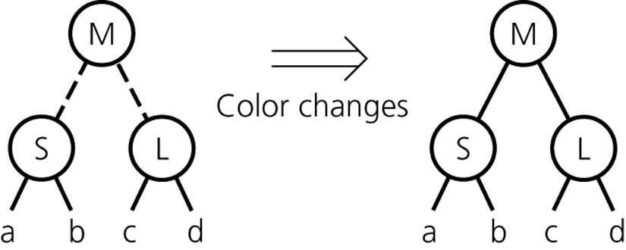
Red-Black Trees: Inserting and Deleting From a Red-Black Tree
Figure 13-34
Splitting a red-black representation of a 4-node that is the root
© 2011 Pearson Addison-Wesley. All rights reserved
13 B-<number>

Slide 8
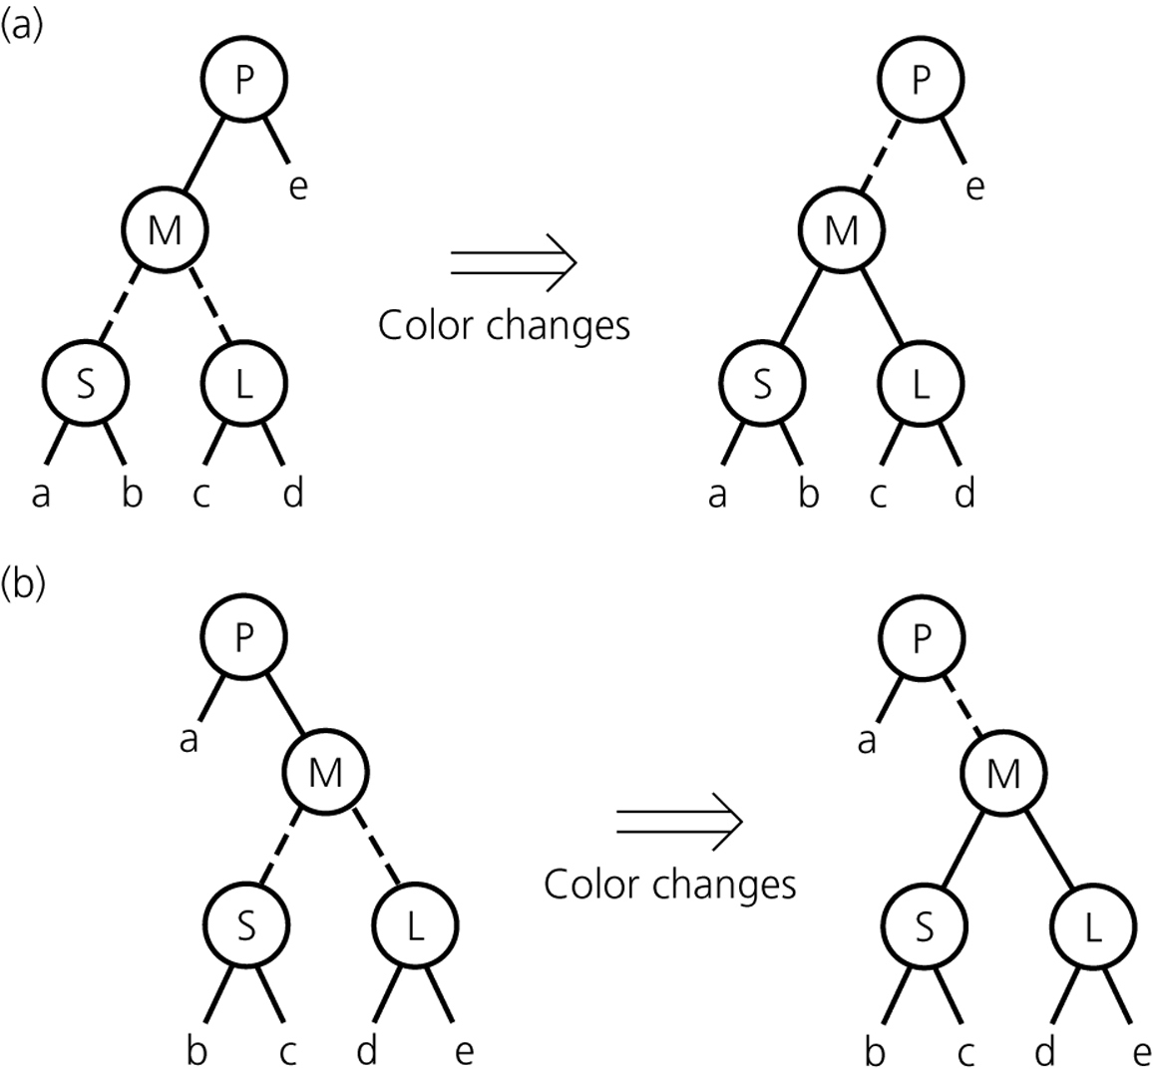
Red-Black Trees: Inserting and Deleting From a Red-Black Tree
Figure 13-35
Splitting a red-black representation of a 4-node whose parent is a 2-node
© 2011 Pearson Addison-Wesley. All rights reserved
13 B-<number>

Slide 9
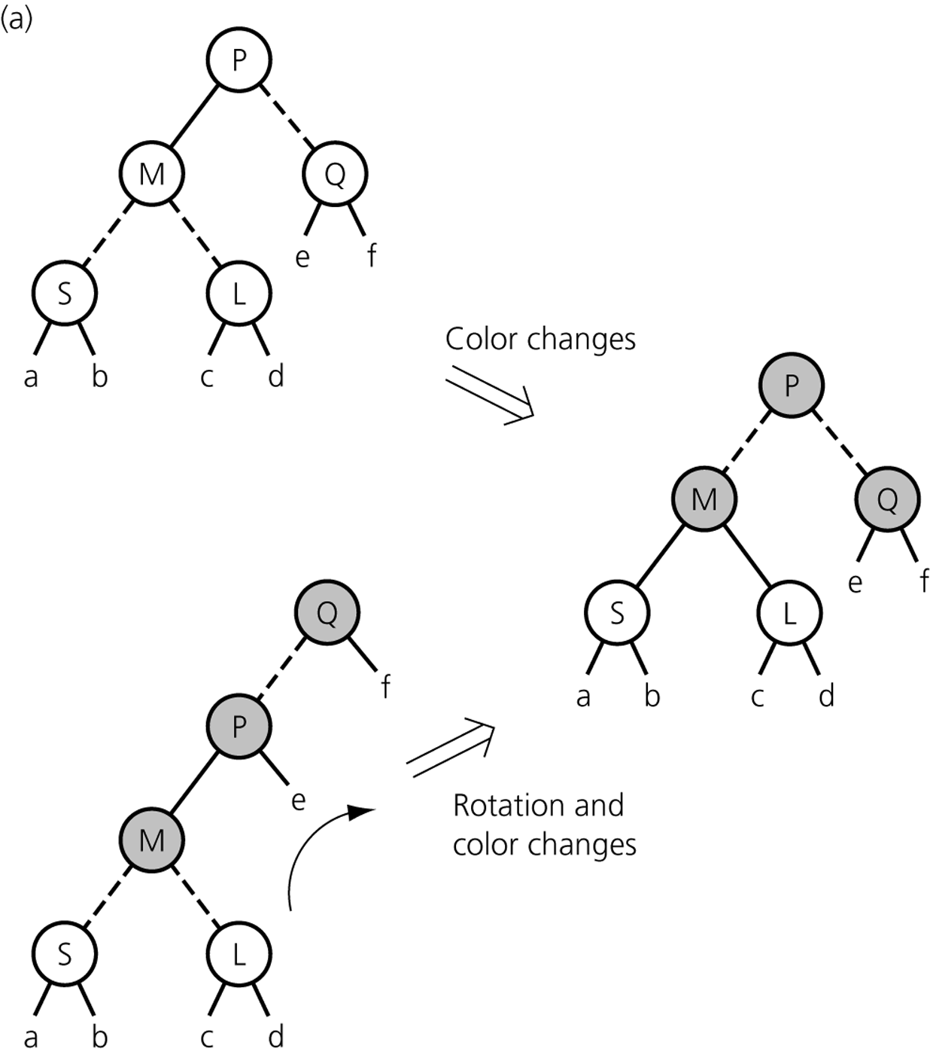
Red-Black Trees: Inserting and Deleting From a Red-Black Tree
Figure 13-36a
Splitting a red-black representation of a 4-node whose parent is a 3-node
© 2011 Pearson Addison-Wesley. All rights reserved
13 B-<number>

Slide 10
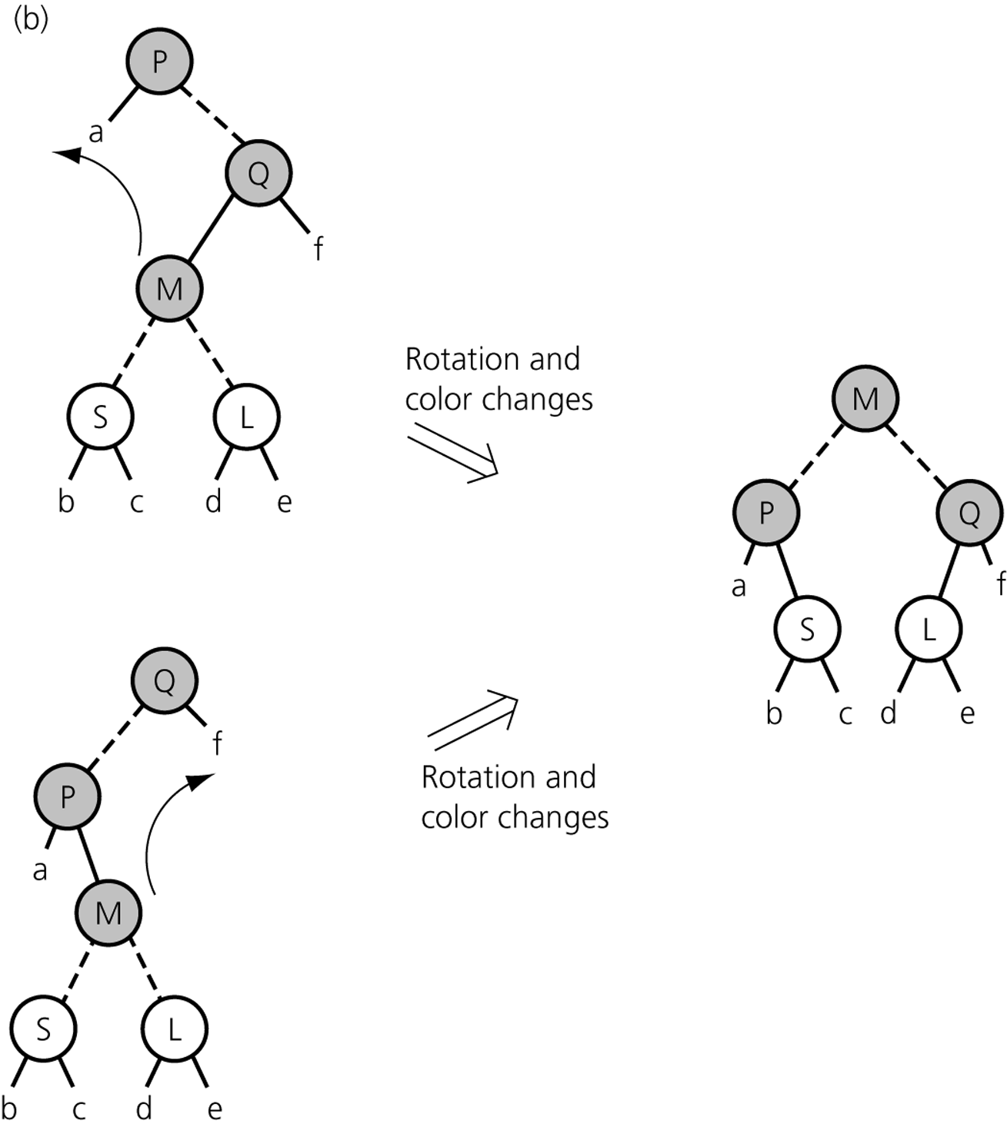
Red-Black Trees: Inserting and Deleting From a Red-Black Tree
Figure 13-36b
Splitting a red-black representation of a 4-node whose parent is a 3-node
© 2011 Pearson Addison-Wesley. All rights reserved
13 B-<number>

Slide 11
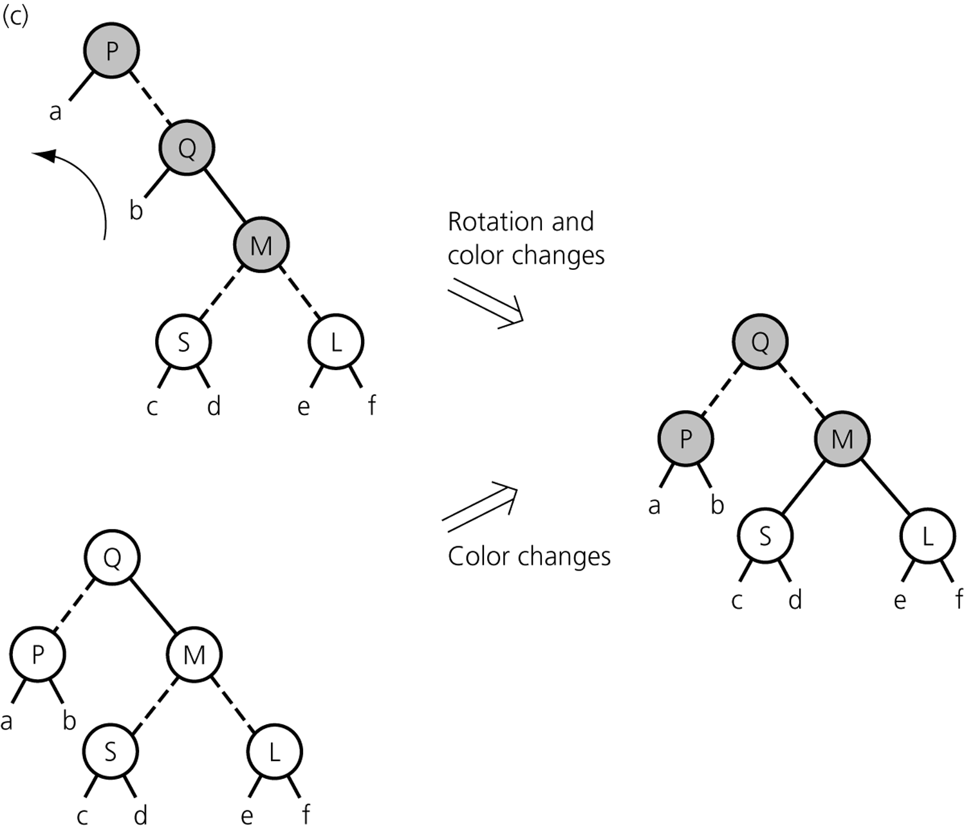
Red-Black Trees: Inserting and Deleting From a Red-Black Tree
Figure 13-36c
Splitting a red-black representation of a 4-node whose parent is a 3-node
© 2011 Pearson Addison-Wesley. All rights reserved
13 B-<number>

Slide 12
AVL Trees
An AVL tree
  A balanced binary search tree
  Can be searched almost as efficiently as a minimum-height binary search tree
  Maintains a height close to the minimum
  Requires far less work than would be necessary to keep the height exactly equal to the minimum
Basic strategy of the AVL method
  After each insertion or deletion
    Check whether the tree is still balanced
    If the tree is unbalanced, restore the balance
© 2011 Pearson Addison-Wesley. All rights reserved
13 B-<number>

Slide 13
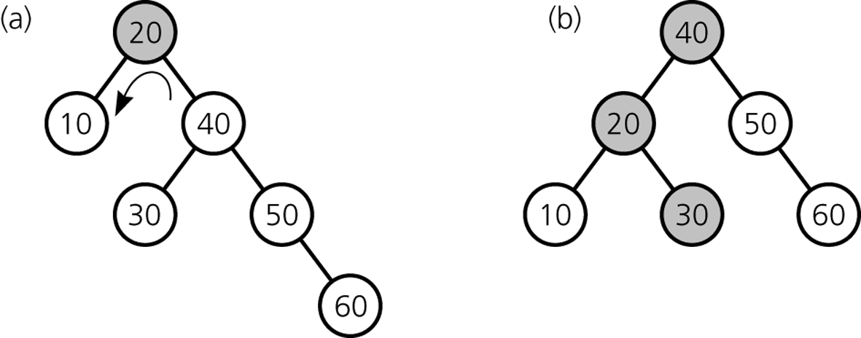
AVL Trees
Rotations
  Restore the balance of a tree
  Two types
    Single rotation
    Double rotation
Figure 13-38
a) An unbalanced binary search tree; b) a balanced tree after a single left rotation
© 2011 Pearson Addison-Wesley. All rights reserved
13 B-<number>

Slide 14
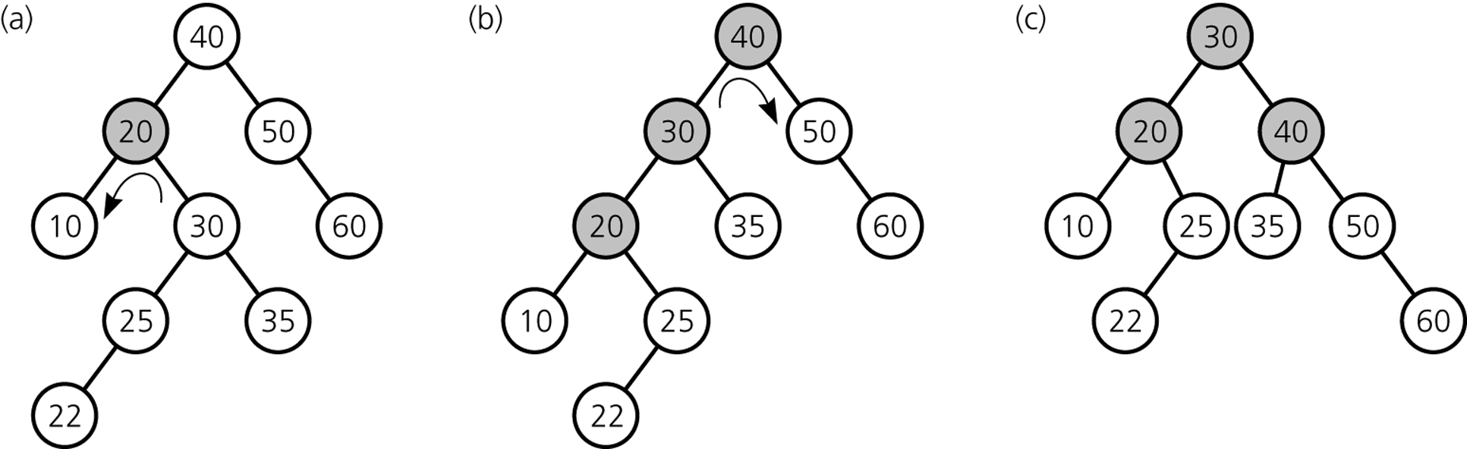
AVL Trees
Figure 13-42
a) Before; b) during; and c) after a double rotation
© 2011 Pearson Addison-Wesley. All rights reserved
13 B-<number>

Slide 15
AVL Trees
Advantage
  Height of an AVL tree with n nodes is always very close to the theoretical minimum
Disadvantage
  An AVL tree implementation of a table is more difficult than other implementations
© 2011 Pearson Addison-Wesley. All rights reserved
13 B-<number>

Slide 16
Hashing
Hashing
  Enables access to table items in time that is relatively constant and independent of the items
Hash function
  Maps the search key of a table item into a location that will contain the item
Hash table
  An array that contains the table items, as assigned by a hash function
© 2011 Pearson Addison-Wesley. All rights reserved
13 B-<number>

Slide 17
Hashing
A perfect hash function
  Maps each search key into a unique location of the hash table
  Possible if all the search keys are known
Collisions
  Occur when the hash function maps more than one item into the same array location
Collision-resolution schemes
  Assign locations in the hash table to items with different search keys when the items are involved in a collision
Requirements for a hash function
  Be easy and fast to compute
  Place items evenly throughout the hash table
© 2011 Pearson Addison-Wesley. All rights reserved
13 B-<number>

Slide 18
Hash Functions
It is sufficient for hash functions to operate on integers
Simple hash functions that operate on positive integers
  Selecting digits
  Folding
  Module arithmetic
Converting a character string to an integer
  If the search key is a character string, it can be converted into an integer before the hash function is applied
© 2011 Pearson Addison-Wesley. All rights reserved
13 B-<number>

Slide 19
Resolving Collisions
Two approaches to collision resolution
  Approach 1: Open addressing
    A category of collision resolution schemes that probe for an empty, or open, location in the hash table
      The sequence of locations that are examined is the probe sequence
    Linear probing
      Searches the hash table sequentially, starting from the original location specified by the hash function
      Possible problem
        Primary clustering
© 2011 Pearson Addison-Wesley. All rights reserved
13 B-<number>

Slide 20
Resolving Collisions
Approach 1: Open addressing (Continued)
  Quadratic probing
    Searches the hash table beginning with the original location that the hash function specifies and continues at increments of 1², 2², 3², and so on
    Possible problem
      Secondary clustering
  Double hashing
    Uses two hash functions
    Searches the hash table starting from the location that one hash function determines and considers every n^{th} location, where n is determined from a second hash function
Increasing the size of the hash table
  The hash function must be applied to every item in the old hash table before the item is placed into the new hash table
© 2011 Pearson Addison-Wesley. All rights reserved
13 B-<number>

Slide 21
Resolving Collisions
Approach 2: Restructuring the hash table
  Changes the structure of the hash table so that it can accommodate more than one item in the same location
  Buckets
    Each location in the hash table is itself an array called a bucket
  Separate chaining
    Each hash table location is a linked list
© 2011 Pearson Addison-Wesley. All rights reserved
13 B-<number>

Slide 22
The Efficiency of Hashing
An analysis of the average-case efficiency of hashing involves the load factor
  Load factor α
    Ratio of the current number of items in the table to the maximum size of the array table
    Measures how full a hash table is
    Should not exceed 2/3
  Hashing efficiency for a particular search also depends on whether the search is successful
    Unsuccessful searches generally require more time than successful searches
© 2011 Pearson Addison-Wesley. All rights reserved
13 B-<number>

Slide 23
The Efficiency of Hashing
Linear probing
  Successful search: ½[1 + 1(1-α)]
  Unsuccessful search: ½[1 + 1(1- α)²]
Quadratic probing and double hashing
  Successful search: -log_{e}(1- α)/ α
  Unsuccessful search: 1/(1- α)
Separate chaining
  Insertion is O(1)
  Retrievals and deletions
    Successful search: 1 + (α/2)
    Unsuccessful search: α
© 2011 Pearson Addison-Wesley. All rights reserved
13 B-<number>

Slide 24
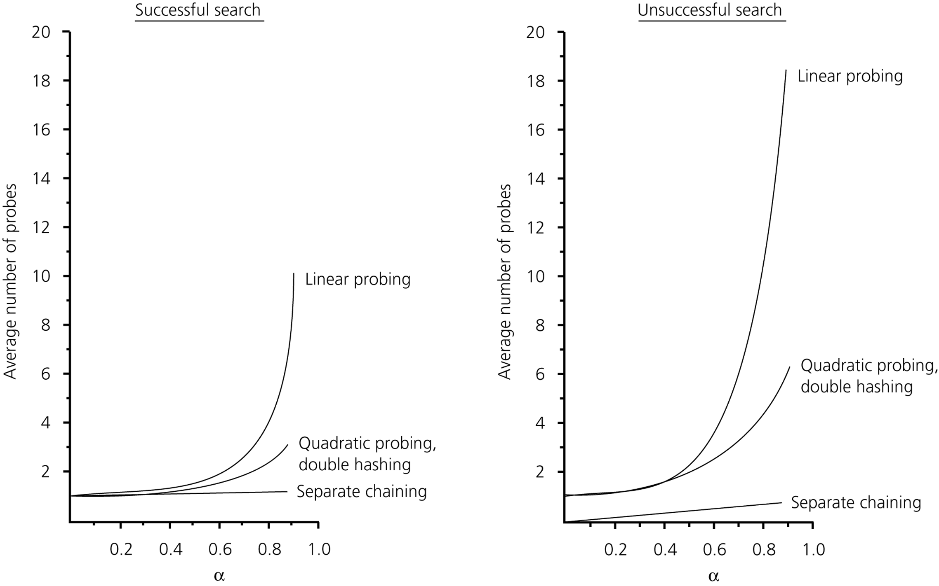
The Efficiency of Hashing
Figure 13-50
The relative efficiency of four collision-resolution methods
© 2011 Pearson Addison-Wesley. All rights reserved
13 B-<number>

Slide 25
What Constitutes a Good Hash Function?
A good hash function should
  Be easy and fast to compute
  Scatter the data evenly throughout the hash table
Issues to consider with regard to how evenly a hash function scatters the search keys
  How well does the hash function scatter random data?
  How well does the hash function scatter nonrandom data?
General requirements of a hash function
  The calculation of the hash function should involve the entire search key
  If a hash function uses module arithmetic, the base should be prime
© 2011 Pearson Addison-Wesley. All rights reserved
13 B-<number>

Slide 26
Table Traversal: An Inefficient Operation Under Hashing
Hashing as an implementation of the ADT table
  For many applications, hashing provides the most efficient implementation
  Hashing is not efficient for
    Traversal in sorted order
    Finding the item with the smallest or largest value in its search key
    Range query
In external storage, you can simultaneously use
  A hashing implementation of the tableRetrieve operation
  A search-tree implementation of the ordered operations
© 2011 Pearson Addison-Wesley. All rights reserved
13 B-<number>

Slide 27
The JCF Hashtable and TreeMap Classes
JFC Hashtable implements a hash table
  Maps keys to values
  Large collection of methods
JFC TreeMap implements a red-black tree
  Guarantees O(log n) time for insert, retrieve, remove, and search
  Large collection of methods
© 2011 Pearson Addison-Wesley. All rights reserved
5 B-<number>

Slide 28
Data With Multiple Organizations
Many applications require a data organization that simultaneously supports several different data-management tasks
  Several independent data structures do not support all operations efficiently
  Interdependent data structures provide a better way to support a multiple organization of data
© 2011 Pearson Addison-Wesley. All rights reserved
13 B-<number>

Slide 29
Summary
A 2-3 tree and a 2-3-4 tree are variants of a binary search tree in which the balanced is easily maintained
The insertion and deletion algorithms for a 2-3-4 tree are more efficient than the corresponding algorithms for a 2-3 tree
A red-black tree is a binary tree representation of a 2-3-4 tree that requires less storage than a 2-3-4 tree
An AVL tree is a binary search tree that is guaranteed to remain balanced
Hashing as a table implementation calculates where the data item should be rather than search for it
© 2011 Pearson Addison-Wesley. All rights reserved
13 B-<number>

Slide 30
Summary
A hash function should be extremely easy to compute and should scatter the search keys evenly throughout the hash table
A collision occurs when two different search keys hash into the same array location
Hashing does not efficiently support operations that require the table items to be ordered
Hashing as a table implementation is simpler and faster than balanced search tree implementations when table operations such as traversal are not important to a particular application
Several independent organizations can be imposed on a given set of data
© 2011 Pearson Addison-Wesley. All rights reserved
13 B-<number>

